Slide 1
Hydraulic Diagram and Calculations

Slide 2

1. Label the Diagram

Slide 3
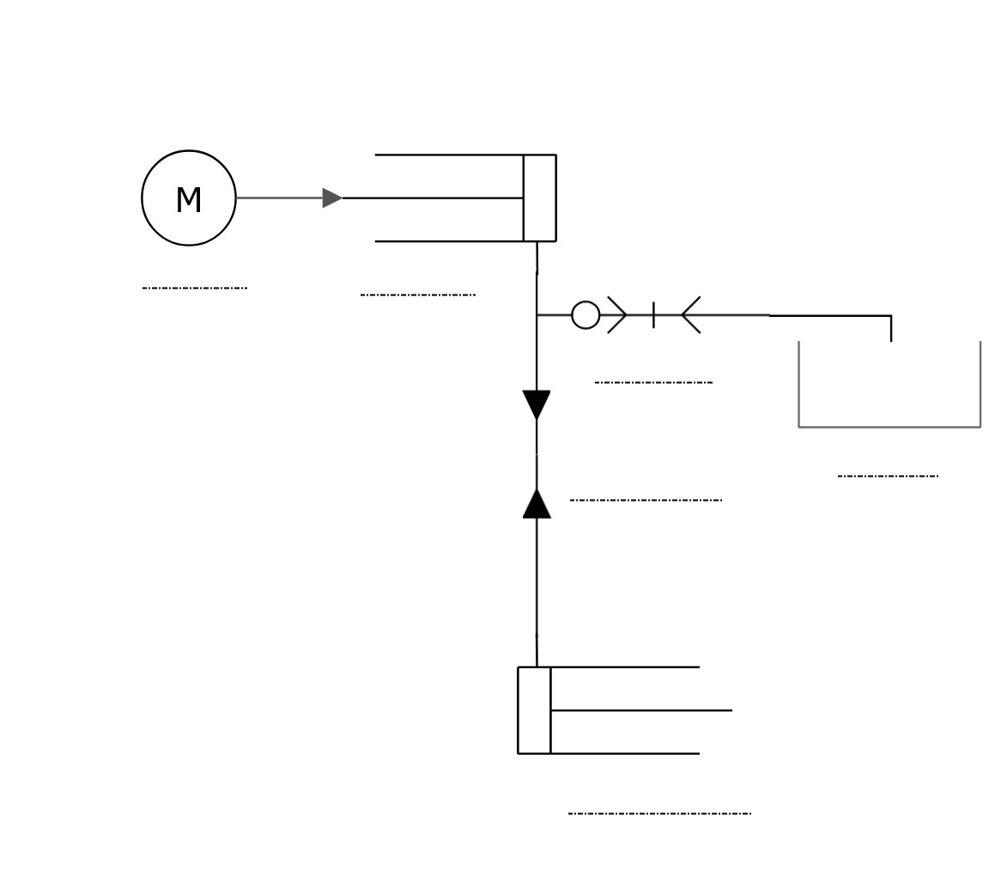

Slide 4
2. Draw the Diagram

Slide 5
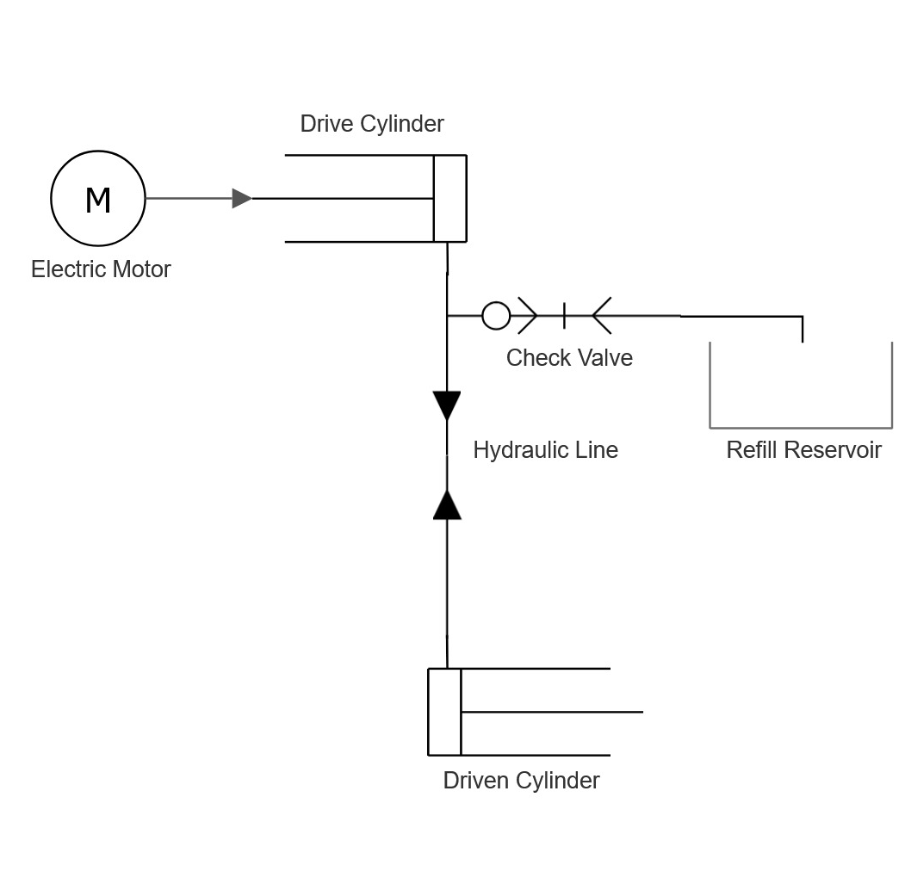

Slide 6

3. Calculations

Slide 7


1 Convert syringe volumes to dimensions

Slide 8






1 Convert syringe volumes to dimensions

Slide 9



2 The linear motor pushes with F = 150 N. The pressure generated in the master syringe is:

Slide 10



3 Force on slave cylinder

Slide 11




4 Velocity of slave cylinder

Slide 12




4 Velocity of slave cylinder

Slide 13



5 Flow rate in hydraulic line

Slide 14






6 Hydraulic line velocity

Slide 15










7 Pressure drop in pipe

Slide 16
Thank you

